Slide 1

Capstone Project-1 Project Title
Exploratory Data Analysis Airbnb Bookings Analysis
Team Members Swapnil Zambare Bhushan Patil Shubham Patil

Slide 2



Slide 3
Data Summary
Airbnb Bookings Analysis
Numerical
Id
Latitude
Longitude
Host id
Availability 365
Price
Minimum Nights
Number of Reviews
Peviews per Months
Calculated host listings count
Airbnb Bookings Analysis
Categorical
Name
Host Name
Neighbourhood Group
Last Review
Neighbourhood
Room Type

Slide 4



Definations
Based on the information on the Airbnb website, the definition of each room type are:
Private room
Guests have exclusive access to the bedroom/sleeping area of the listing. Other parts area such as
the living room, kitchen, and bathroom are likely open either to the host even to other guests.
Entire home/apt
Guests have the whole place for themselves. It usually includes a bedroom, bathroom, and kitchen.
Shared Room
Guest sleep in a bedroom or a common area that could be shared with others. bold text.

Slide 5
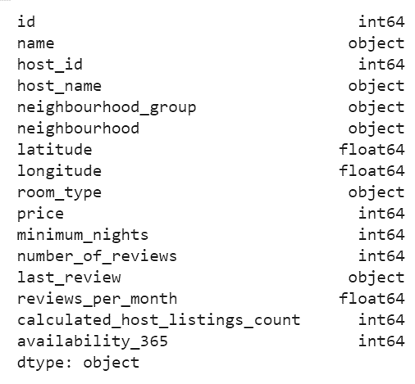
Dataset
There are 48895 entries and 16 columns
10 out of 16 are numeric:
(Id, host_id, latitude, longitude, price, minimum_nights, number_of_reviews, reviews_per_month, calculated_host_listings_count, availability_365)
6 out of 16 are categorical:
(name, host_name, neighbourhood_group, neighbourhood, room_type, last_review)

Slide 6
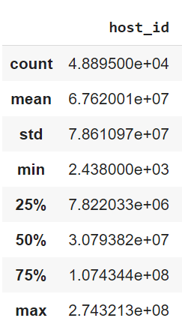
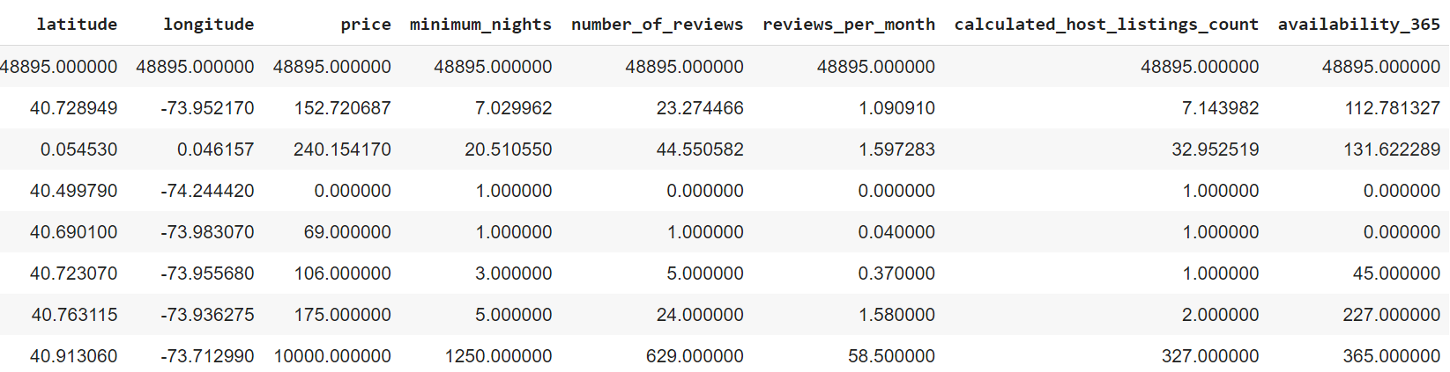
Descriptive Analysis
All columns except latitude and longitude have a big gap between the third quartile and the max value.
The min value of price, number_of_reviews, reviews_per_month and availability_365 is 0.
calculated_host_listings_count max value is 327 is very far as compare to quartile value.
Also max value of minimum_nights is very far as compare to quartile value.

Slide 7
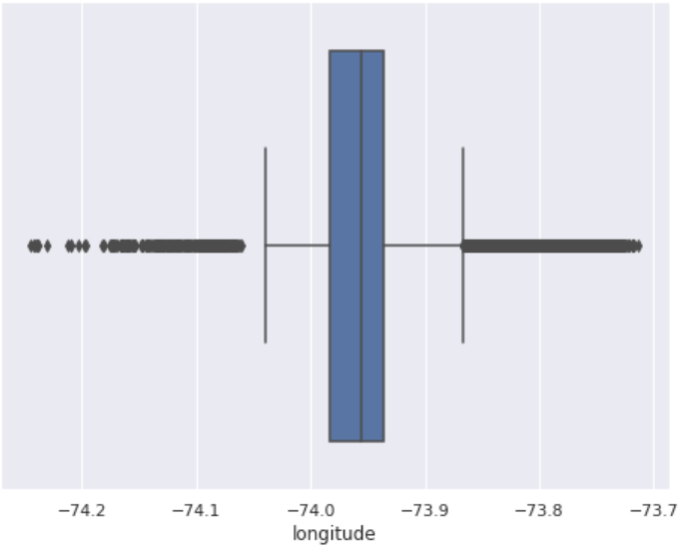
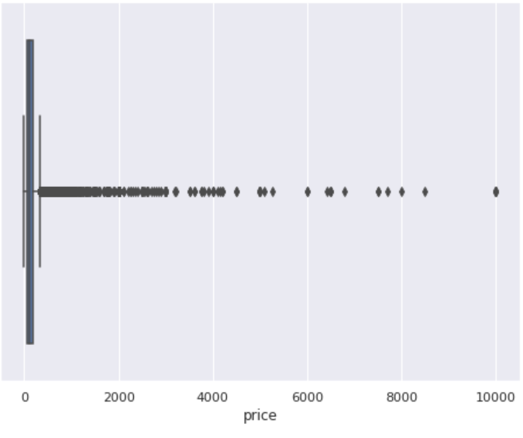
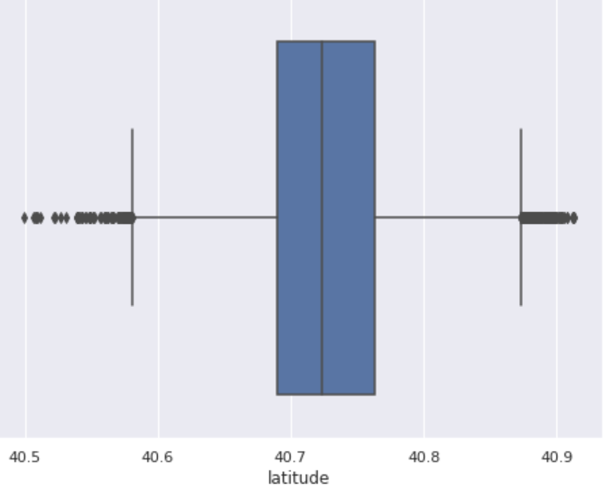
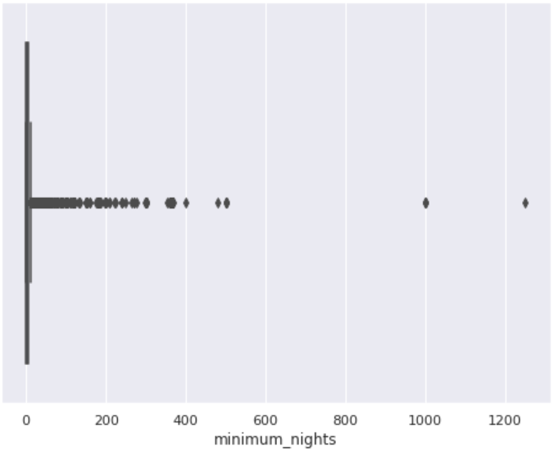
Outliers Data
In price and minimum_nights outliers are present. Also outliers are present in longitude and latitude but we don’t take action on them.

Slide 8
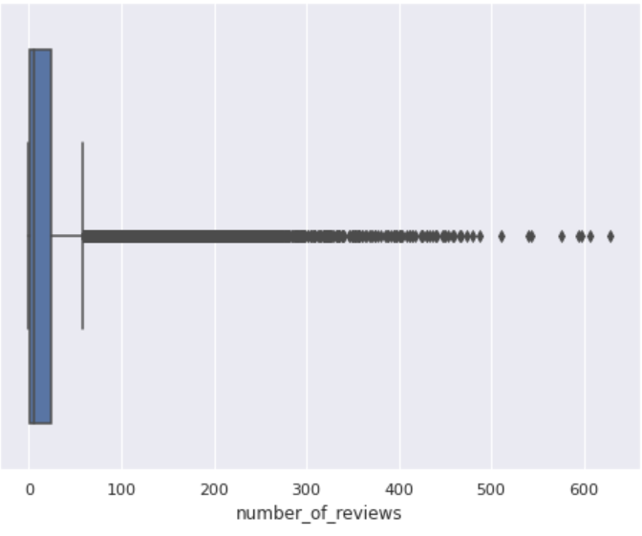
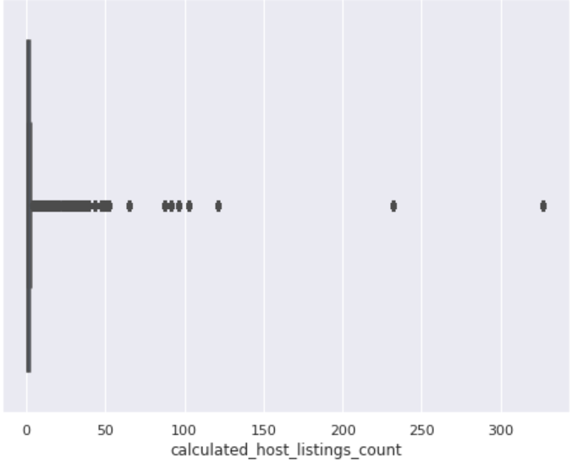
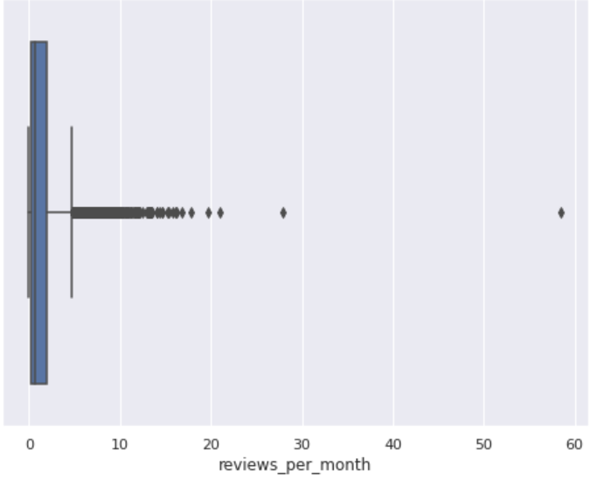
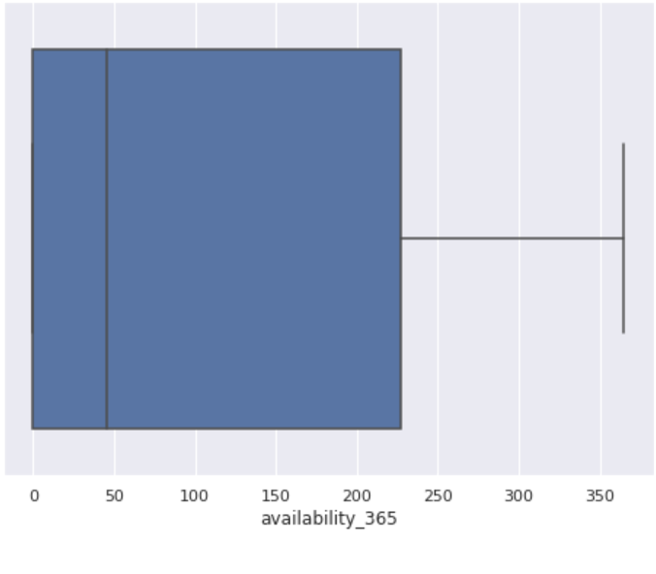
Outliers are present in number_of_reviews, reviews_per_month, calculated_host_listings_count
But for availability_365 there is no single outlier.

Slide 9
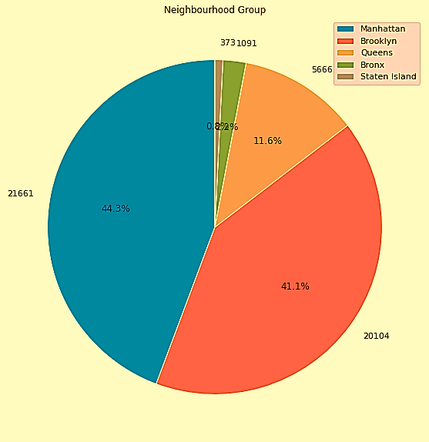
Neighbourhood Group
We have to try to check out the percentage of each
neighbourhood group. It turns out that many rooms
are rented out in two areas: Manhattan 44.3% and
Brooklyn 41.1%. Staten island cover very low area
as compare to other four neighbourhood group.

Slide 10
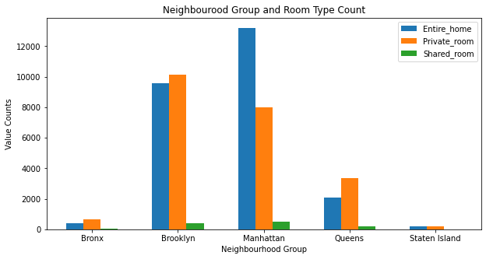
Neighbourhood Group and Room Type
Average price per neighbourhood group and room type shows that Manhattan is the neighbourhood
group with the highest room type when compare to other neighbourhood group.
Neighbourhood Group | Room Type | Count
Bronx | Private room | 652
 | Entire home/apt | 379
 | Shared room | 60
Brooklyn | Private room | 10132
 | Entire home/apt | 9559
 | Shared room | 413
Manhattan | Entire home/apt | 13199
 | Private room | 7982
 | Shared room | 480
Queens | Private room | 3372
 | Entire home/apt | 2096
 | Shared room | 198
Staten Island | Private room | 188
 | Entire home/apt | 176
 | Shared room | 9

Slide 11
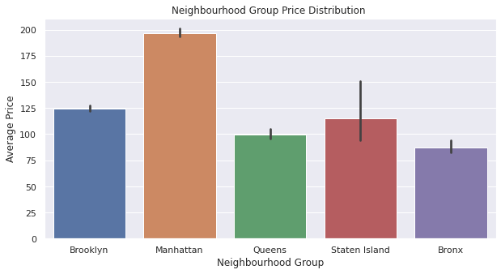
Average price per night
Average price per night of top 100 reviewed listings is 95.53
Whole average price per night in New York is 152.72
Average price per night in each neighbourhood group
Neighbourhood Group | Average Price
Bronx | 87.496792
Brooklyn | 124.383207
Manhattan | 196.875814
Queens | 99.517649
Staten Island | 114.812332

Slide 12
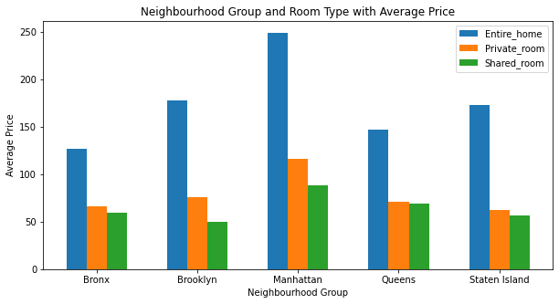
Average Price of Each Room Type in Each Neighbourhood Group
Neighbourhood Group | Room Type | Average Price
Bronx | Private room | 127
 | Entire home/apt | 66
 | Shared room | 59
Brooklyn | Private room | 178
 | Entire home/apt | 76
 | Shared room | 50
Manhattan | Entire home/apt | 249
 | Private room | 116
 | Shared room | 88
Queens | Private room | 147
 | Entire home/apt | 71
 | Shared room | 69
Staten Island | Private room | 173
 | Entire home/apt | 62
 | Shared room | 57

Slide 13
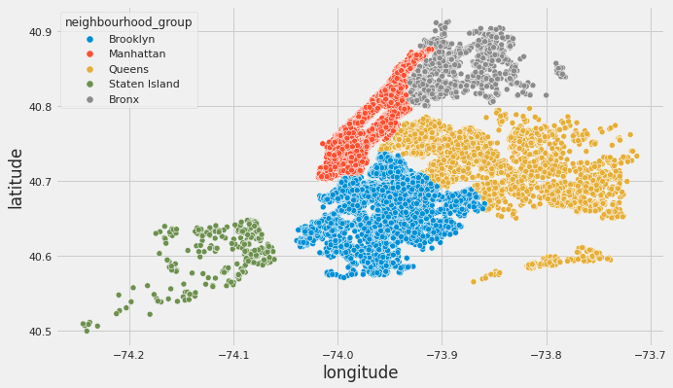
Mapping Neighbourhood Group with Lishtings
The below pie chart shows that Manhattan and Brooklyn has highest share of listing as compare to other three.
Manhattan and Brooklyn are most traveled destinations.
Neighbourhood Group | Listings
Manhattan | 21661
Brooklyn | 20104
Queens | 5666
Bronx | 1091
Staten Island | 373

Slide 14
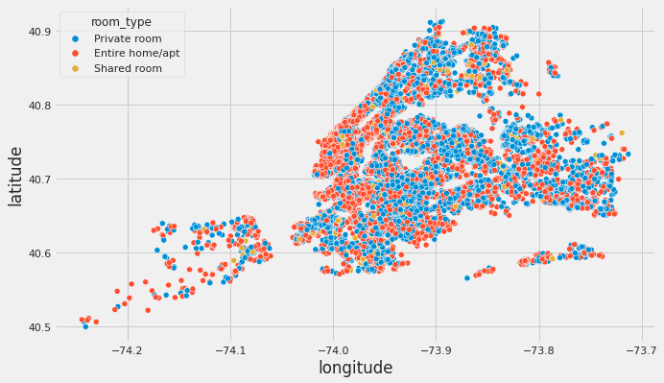
Distribution of Room Type in NYC
More area covered by Entire home/apt and number of rooms are 25409.
Least area covered by Shared room and number of rooms are 1160.
Room Type | Count
Entire home/apt | 25409
Private room | 22326
Shared room | 1160

Slide 15
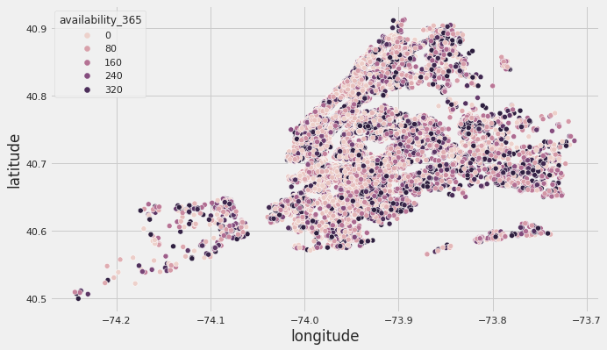
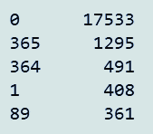
Room Availability
More number of rooms are available 0 days of year but less number of rooms are available 202 days
of year which are 20. Whole year available rooms are 1295.
Manhatten has less room availability during 365 days.
As people are mostly prefer these areas for bookings.

Slide 16
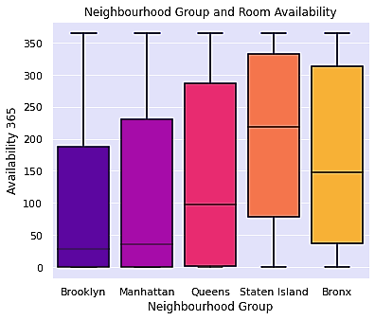
Availability of Room in Entire Year
Brooklyn and Manhatten region is most busy region as there is very les availability of room
while in Staten Island there is more than average 200 days rooms are availabe as people are
less prefer than other region.

Slide 17
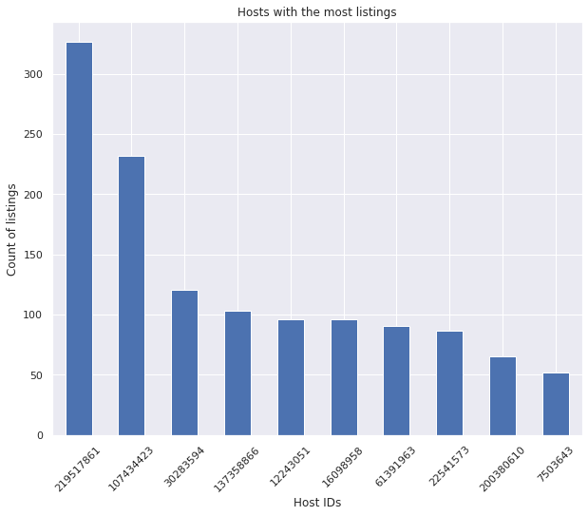
Top busiest Host
Total of top 10 hosts is almost 2%( 1270 listings) of the whole dataset.
Host id | Listings
219517861 | 327
107434423 | 232
30283594 | 121
137358866 | 103
12243051 | 96
16098958 | 96
61391963 | 91
22541573 | 87
200380610 | 65
7503643 | 52

Slide 18
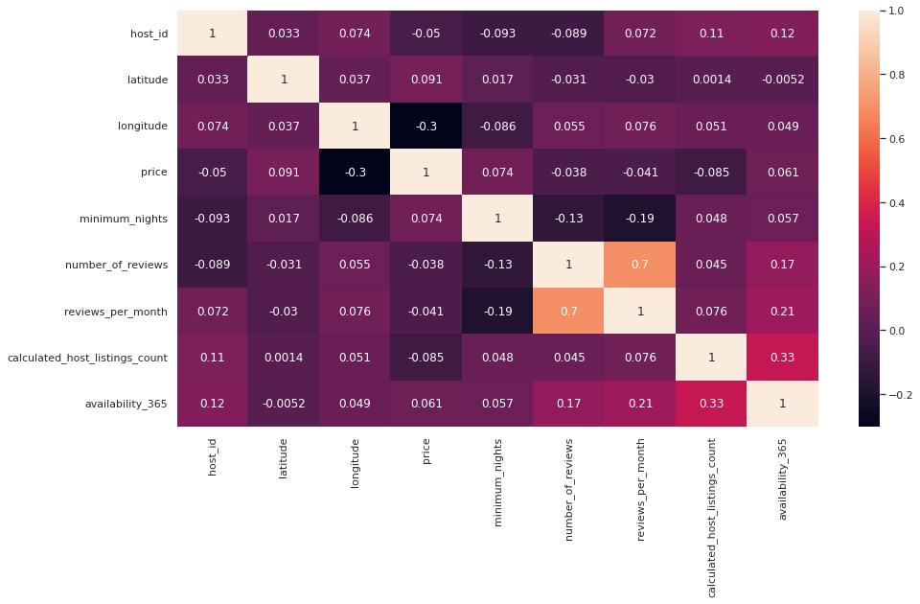
Correlation matrix

Slide 19
Conclusion
First we have found that host that take good use of Airbnb platform and provide the most listings; we found that our top host has 327 listings.
Simply by performing EDA on the dataset, we’ve identified various new insight on how the Airbnb listings distributed on New York, we know where are the listings located, found out the Manhattan is dominating the listing number and have the highest price range
After we found that which neighbourhood group has more number of boroughs and higher listing densities and which area is more popular than other. Also we found which neighbourhood has higher number of listings.
Next, we do the good use of longitude and latitude to create color coded geographical map of neighbourhood group, room type and room availability.
We also found neighbourhood group price distribution and room availability.In which we boxplot the data.
Overall, we found good relationships between features and explained each step of the process.

Slide 20


